Slide 1

Concurrency: Reactive vs Shared State
Benchmarking Akka actors against shared-state concurrency
June 17th, 2015

Slide 2

ABOUT ME | DANA PEELE, SR APPLICATION DEVELOPER
Developer
Rock climber
Dad
Scala junkie

Slide 3

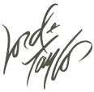


Four E-commerce banners
NOT an agency
Strong engineering culture
Incredible stacks
Scala/Play/Akka/Mongo
React/Backbone/Marionette

Slide 4
Concurrency
Multiple threads executing simultaneously
Our example- an inventory web service with multiple clients making requests in parallel
Challenge- ensure that we don’t sell inventory we don’t have
Inventory Web Service

Slide 5
Options to Handle Concurrency
Shared-State
Akka (Reactive)
Other:
Function Reactive Programming
Publisher/Subscriber
Communicating sequential processes
Software transactional memory
Notes:
Function Reactive Programming (Not the same as Reactive)- composable streams
Publisher/Subscriber- ex JavaScript event handling
Communicating sequential processes- similar to actor model (Akka) but messages are synchronous and processes are anonymous
Software transactional memory- analogous to database transactions, built into Clojure and implemented in many languages (Java, Haskell, Ocaml)

Slide 6
Shared-State
Shares mutable state across threads
Uses locks/synchronized blocks to prevent race conditions
Proven and well understood
In widespread use for a long time
Simple to reason about for trivial applications
Complex applications are very difficult to model
Thread sleep/awake is expensive
Deadlocks!

Slide 7
Akka (Reactive)
Actors instead of threads
Actors communicate with message passing
Mutable state, but…
Each actor has a mailbox (queue)
Loose coupling
Requires care in modeling and refactoring to ensure resiliency and performance
Dangerous tasks and mutable state don’t mix and require supervision
Can’t multi-thread mutation
Notes:
Actors instead of threads
Lightweight, easy to reason about (actor’s are like people… specialized and one task at a time), delegate and supervise
Actors communicate with message passing
Messages are objects containing information, they aren’t imperative, they’re reacted to
Mutable state
But only an actor can change itself (state isn’t shared)
Each actor has a mailbox (queue)
Synchronous message processing (No locks, blocking, or thread sleep)
Loose coupling
Messages are strongly typed, receive method that processes them isn’t

Slide 8
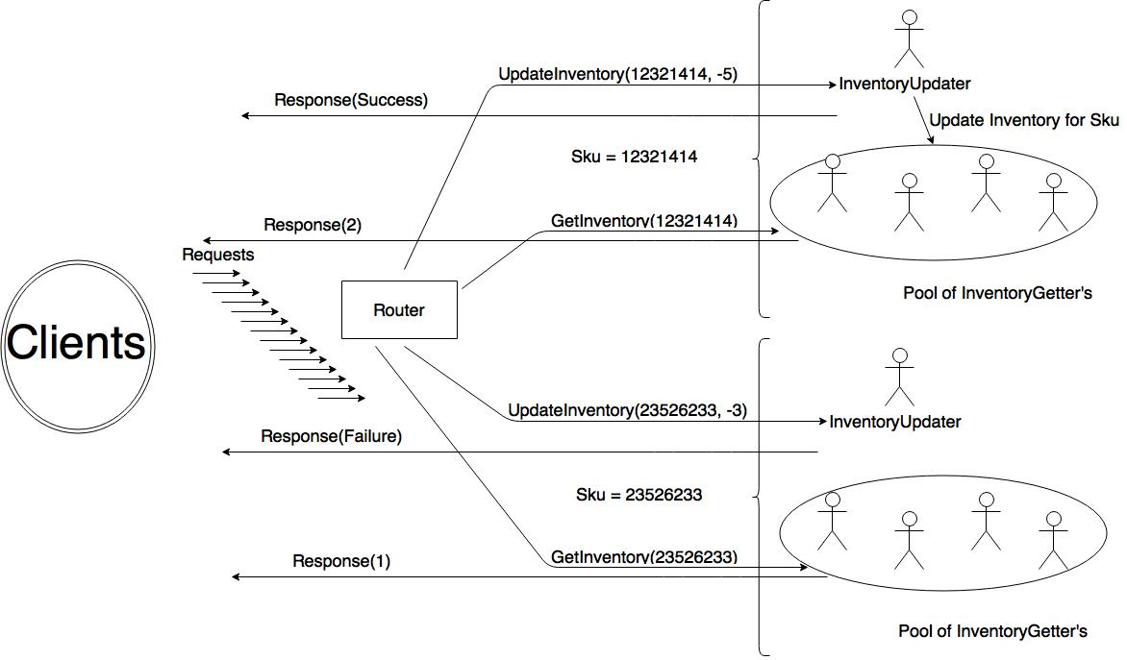

Slide 9
DevOps
At HBC we are using
Kitchen (testing)
Vagrant (virtual machines)
Puppet (provisioning)
Librarian Puppet (more provisioning)
Docker (containers)
We practice Infrastructure as code
versioning
pull requests
code review
regression testing
reproducibility
Linux base box
Puppet Librarian
to source modules for SBT, Java, MongoDB, and Docker
Installed in my base box (provision)
spin up and deploy a Docker container running StatsD and Graphite
Run Play applications with SBT and Java while running MongoDB, StatsD, and Graphite instances ready to use.
Notes:
Right column is Dev Ops used in this demo. Now let’s look at code!!!

Slide 10
Inventory Applications- Shared Elements
Play web framework
Built on Akka
Netty web server, a non-blocking I/O client-server framework (Originally developed by JBoss)
Incorporates logging and configuration management
ReactiveMongo
Non-blocking, asynchronous MongoDB driver built on Akka Streams
Database ops return an immediately future and (may) eventually complete
Metrics
StatsD (aggregator): data received via one-way udp protocol, sends to Graphite
Graphite: Dashboard web application

Slide 11
Shared-State Inventory Application
Application controller
Uses TrieMap of InventoryQuantity instances keyed to product sku (id)
val inventory = TrieMap[String, InventoryQuantity]()
val r = scala.util.Random
for (sku <- 1 to 100) {
val quantity = r.nextInt(10000) + 10000
inventory.put(sku.toString, new InventoryQuantity(quantity))
mongoRepo.setInventory(sku.toString, quantity)
}
Handler methods
Notes:
Handler methods
getInventory
updateInventory
Persists the new value to Mongo if quantity changes
Both handler methods respond to the request and then send out metrics.

Slide 12
Shared-State: updateInventory Handler
def updateInventory(sku: String, quantityChange: Int) = Action.async ({
request =>
val startTime = System.currentTimeMillis
val f = Future {
Logger.debug("update inventory called")
val skuInventoryOption = inventory.get(sku)
var result = NotFound(Json.toJson(InventoryResponseModel("update", sku, success = false, 0, "sku not found")))
skuInventoryOption match {
case Some(skuInventory) =>
val response = skuInventory.updateQuantity(quantityChange)
result = Ok(
Json.toJson(
InventoryResponseModel(
"update", sku, success = response._1, quantityChange, if (!response._1) s"Only ${response._2} left" else ""
)))
response._1 match {
case true => mongoRepo.setInventory(sku.toString, response._2)
case _ =>
}
case _ =>
}
result
}
f.onComplete({case _ =>
statsDSender ! SendTimer("shared-state.update.duration", System.currentTimeMillis - startTime)
statsDSender ! IncrementCounter("shared-state.update.count")
})
f
})
}

Slide 13
Shared-State: InventoryQuantity Model
def updateQuantity(quantityUpdate: Int): (Boolean, Int) = {
var returnValue: (Boolean, Int) = (false, quantity)
writeLock.lock()
quantityUpdate >= 0 || quantity + quantityUpdate >= 0 match {
case true =>
quantity += quantityUpdate
returnValue = (true, quantity)
case _ =>
}
writeLock.unlock()
returnValue
}
Notes:
Dirty reads but synchronized writes using a lock.

Slide 14
Reactive Inventory Application
Application controller
Actor system
val akkaSystem = ActorSystem("reactive-inventory")
Initialize actors
for (sku <- 1 to 100) {
val quantity = r.nextInt(10000) + 10000
val skuString = sku.toString
val inventoryUpdater = akkaSystem.actorOf(
Props(classOf[InventoryUpdater], skuString, quantity, MongoRepo))
inventoryUpdaters.put(sku.toString, inventoryUpdater)
val routees: Seq[ActorRef] =
for (routeeId <- 1 to 10) yield {
val routee = akkaSystem.actorOf(
Props(classOf[InventoryGetter], skuString, quantity))
inventoryUpdater ! RegisterListener(routee)
routee
}
inventoryGetters.put(
sku.toString,
akkaSystem.actorOf(RoundRobinGroup(routees.map(_.path.toStringWithoutAddress).toList).props()))
}
Notes:
Actor system
actor hierarchy that shares configuration.
Play has it’s own internal actor system that we can use if we only have a couple of actors.
But since we have 1100 actors and we’re expecting a lot of load on the site we create another actor system to separate the http server from the application layer.
Initialize the actors
For each sku we instantiate an InventoryUpdater actor and a pool of 10 InventoryGetter actors.
This bring up a crucial point in regards to Akka design.
We don’t have a pool of actors with access to all inventory, that would require shared-state which we are avoiding.
So instead we essentially shard the data by sku so that we are able to multithread the processing.

Slide 15
Reactive Inventory Application
Application controller (cont)
inventoryUpdater ! RegisterListener(routee)
Handlers
def updateInventory(sku: String, quantityChange: Int) = Action.async ({
val startTime = System.currentTimeMillis()
val f = (inventoryUpdaters.getOrElse(sku,akkaSystem.deadLetters) ?
UpdateInventory(quantityChange)).mapTo[Result]
f.onComplete({case _ =>
statsDSender ! SendTimer("reactive.update.duration",
System.currentTimeMillis - startTime)
statsDSender ! IncrementCounter("reactive.update.count")
})
f
})
Notes:
inventoryUpdater ! RegisterListener(routee)- Register getters as listeners for each updater
We’ll look at the code in the actors related to this later but what is happening here is that each of the 10 InventoryGetter’s is registering with the corresponding InventoryUpdater so that when it changes the inventory it can send them a message to tell them to update their inventory as well.
Handlers
Ask the actor for a reply to get or update
This creates a future that (may) complete with response
On completion of future send metrics

Slide 16
Reactive Inventory Application (Actors)
EventSource
InventoryUpdater
object InventoryUpdater {
case class UpdateInventory(quantity: Int)
}
class InventoryUpdater(sku: String, var quantity: Int, mongoRepo : MongoRepoLike) extends Actor
…
//Persist inventory to Mongo
def callSetInventory (sku: String, quantity: Int) = {
…
}
callSetInventory (sku, quantity)
def inventoryReceive: Receive = {
//update inventory
case UpdateInventory(modQuantity) =>
…
modQuantity >= 0 || quantity + modQuantity >= 0 match {
case true =>
quantity += modQuantity
sendEvent(UpdateInventory(quantity))
callSetInventory(sku, quantity)
…
}
sender ! Ok(Json.toJson(InventoryResponseModel("update", sku, success = success, modQuantity, message)))
}
def receive = eventSourceReceive orElse inventoryReceive
}
Notes:
EventSource
Actor trait that we will mix in to the InventoryUpdater actor that allows the InventoryGetter actors to register to receive messages.
Defines a partial function of type Receive where we accept messages to register and unregister listeners and store them in a vector.
InventoryUpdater
Companion object defining messages.
Constructor parameters to initialize state
Method to persists inventory to the database and an immediate call to this method to persist initial inventory
Partial function, to handle incoming requests to modify the inventory.
Confirms that the request is valid (i.e. we have enough inventory to satisfy it),
Updates the quantity
Sends a message to all the listeners (the InventoryGetter’s) to update their inventory
Persists to mongo if appropriate
Send the response back to the http client to complete the future
Finally we set the receive method for this actor (where all incoming messages are sent) to a combination of the partial function we just defined and the one from the EventSource trait by using orElse. Basically this says, if the message isn’t handled by the first partial function, try the 2nd one.
InventoryGetter
Similar to but simpler than the InventoryUpdater
Handles requests for the current inventory level of the product
NOW WE RUN THE CODE
Vagrant up
Start web apps
Hit web apps from command line and browser
Use Jmeter
Show Graphite
Next steps (if this were not a toy)
Some next steps to make this application more robust would be a more thought out hierarchy and supervision (parents handling when child actors experience exceptions), persisting actor state to disk to allow recovery of mutable state after application failure, better error handling for bad routes, implementation of a timeout for requests, refactoring boilerplate code into filters, creating a service layer to remove functionality from the controller, increased logging, and increased testing.

Slide 17
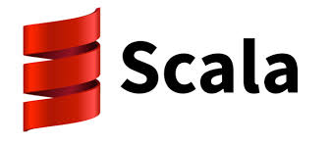



Q&A

Slide 18
Obligatory We Are Hiring Slide
Surprise! We are hiring.
Follow us:
Twitter: @HBCDigital
LinkedIn: https://www.linkedin.com/company/hbc_digital?trk=biz-companies-cym
Contact Info:
dana_peele@s5a.com
@Dana_S_Peele
Repo for the demo and slideshow:
https://github.com/saksdirect/react-vs-shared-state-inventory

